Slide 1
AllianceBernstein Capstone Project
3.6 Weekly Update
Hongyu Dai

Slide 2
Previous takeaway
TX data
Modify data structure of datadict file
5-years time series analysis
CA Web Scraping
Code need to be improve

Slide 3
Quick Summary
TX 5-years trend analysis
Accomplishment:
Using function and pipeline to integrate codes
Add plots: line, box, scatter, pct change
CA Web Scraping
Accomplishment: Improve and debug for web scarping codes
Sample data have been upload to GitHub for reference. hydai99/Capstone-AllianceBernstein (github.com)
All data can be upload by tomorrow

Slide 4
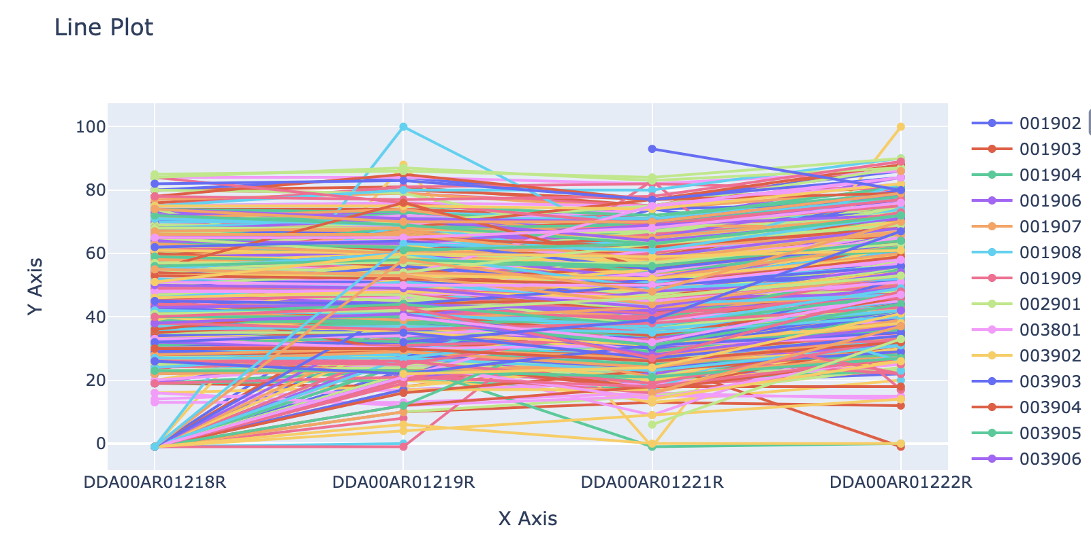
TX 5-years trend analysis

Slide 5
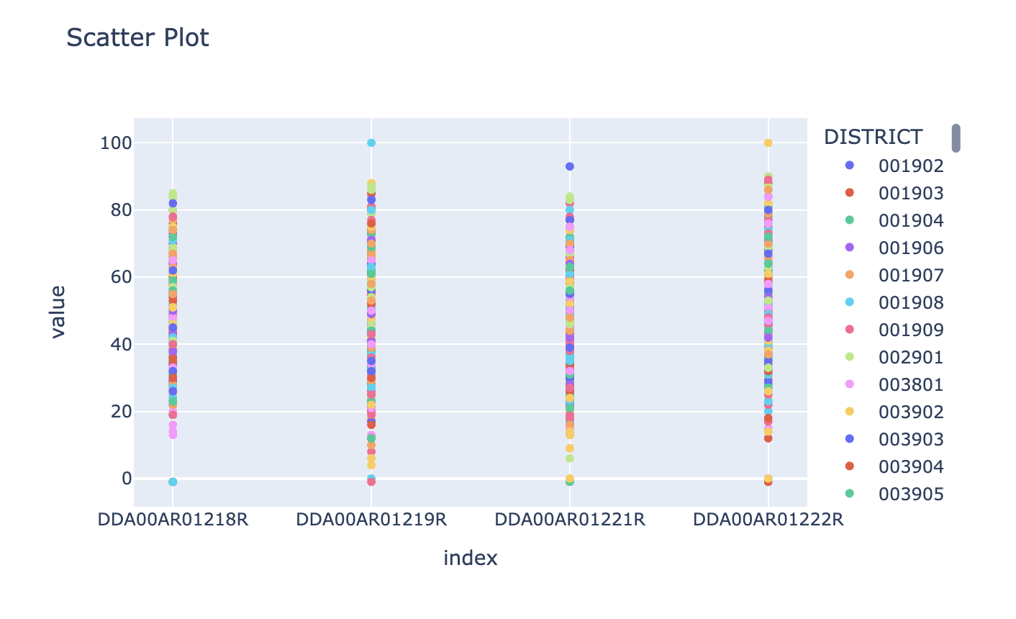
TX 5-years trend analysis

Slide 6
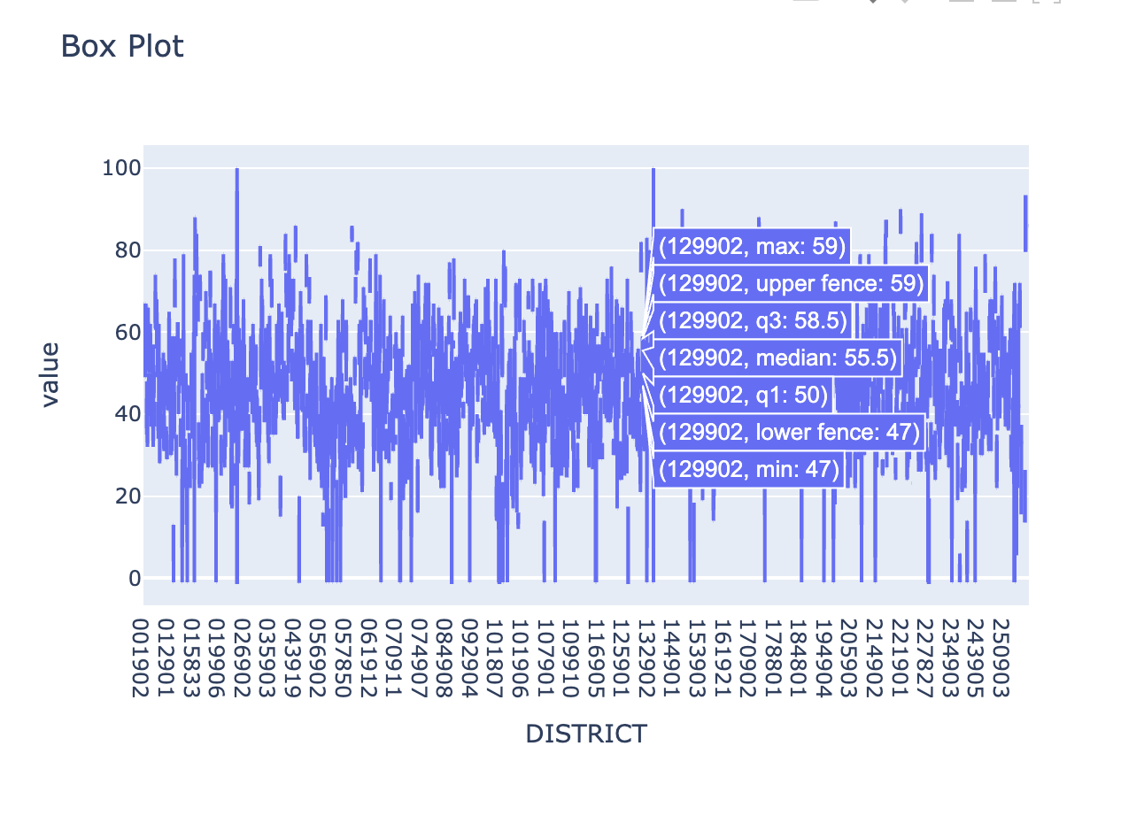
TX 5-years trend analysis

Slide 7
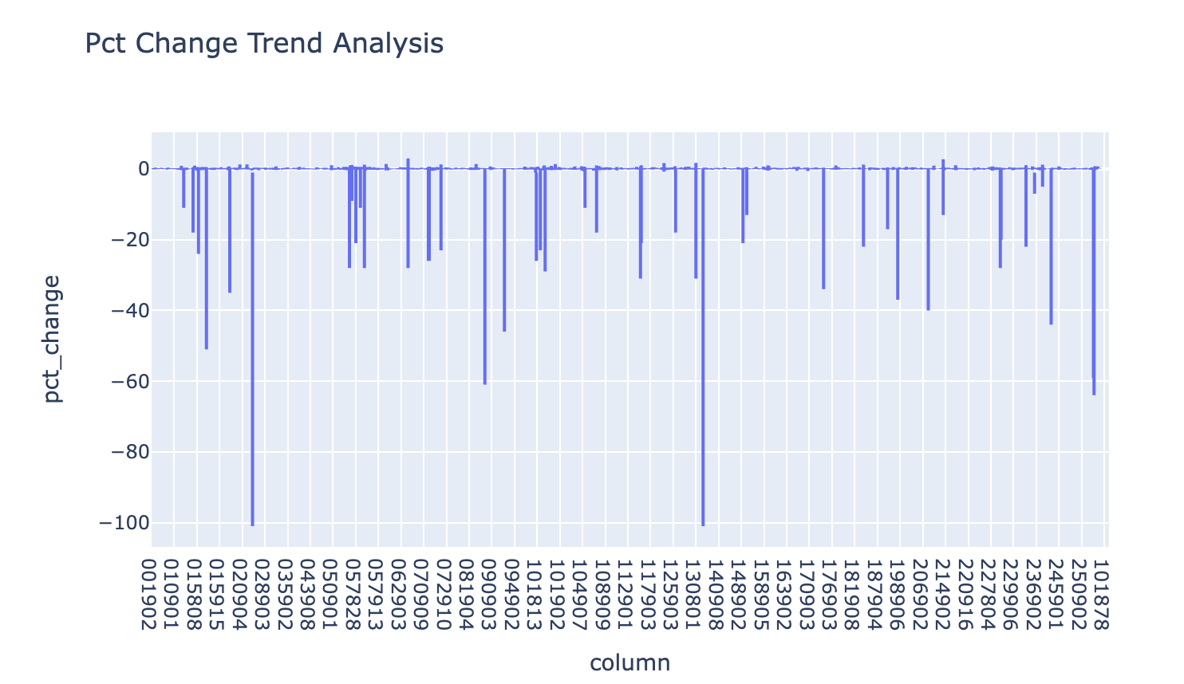
TX 5-years trend analysis

Slide 8
CA Web Scraping
A lot of improvements have been made to the code.
Tested each report to make sure there were no bugs
Sample data have been upload to GitHub for reference. hydai99/Capstone-AllianceBernstein (github.com)

Slide 9
Next steps
Upload CA data
Check next state data?

